Slide 1

Cyber security: Protecting the Digital World
Stay Safe, Stay Secure
By: FALAQ IQBAL(25CABSA558)

Slide 2
What is Cyber security?
• Protection of systems, networks, and data
• Prevents cyber-attacks and data breaches
• Essential for individuals, businesses, and governments

Slide 3
Types of Cyber Threats
Threat Type | Example | Impact
Malware | Viruses, Ransomware | Data loss
Phishing | Fake emails/websites | Identity theft
DDoS Attack | Overloaded servers | Service disruption

Slide 4
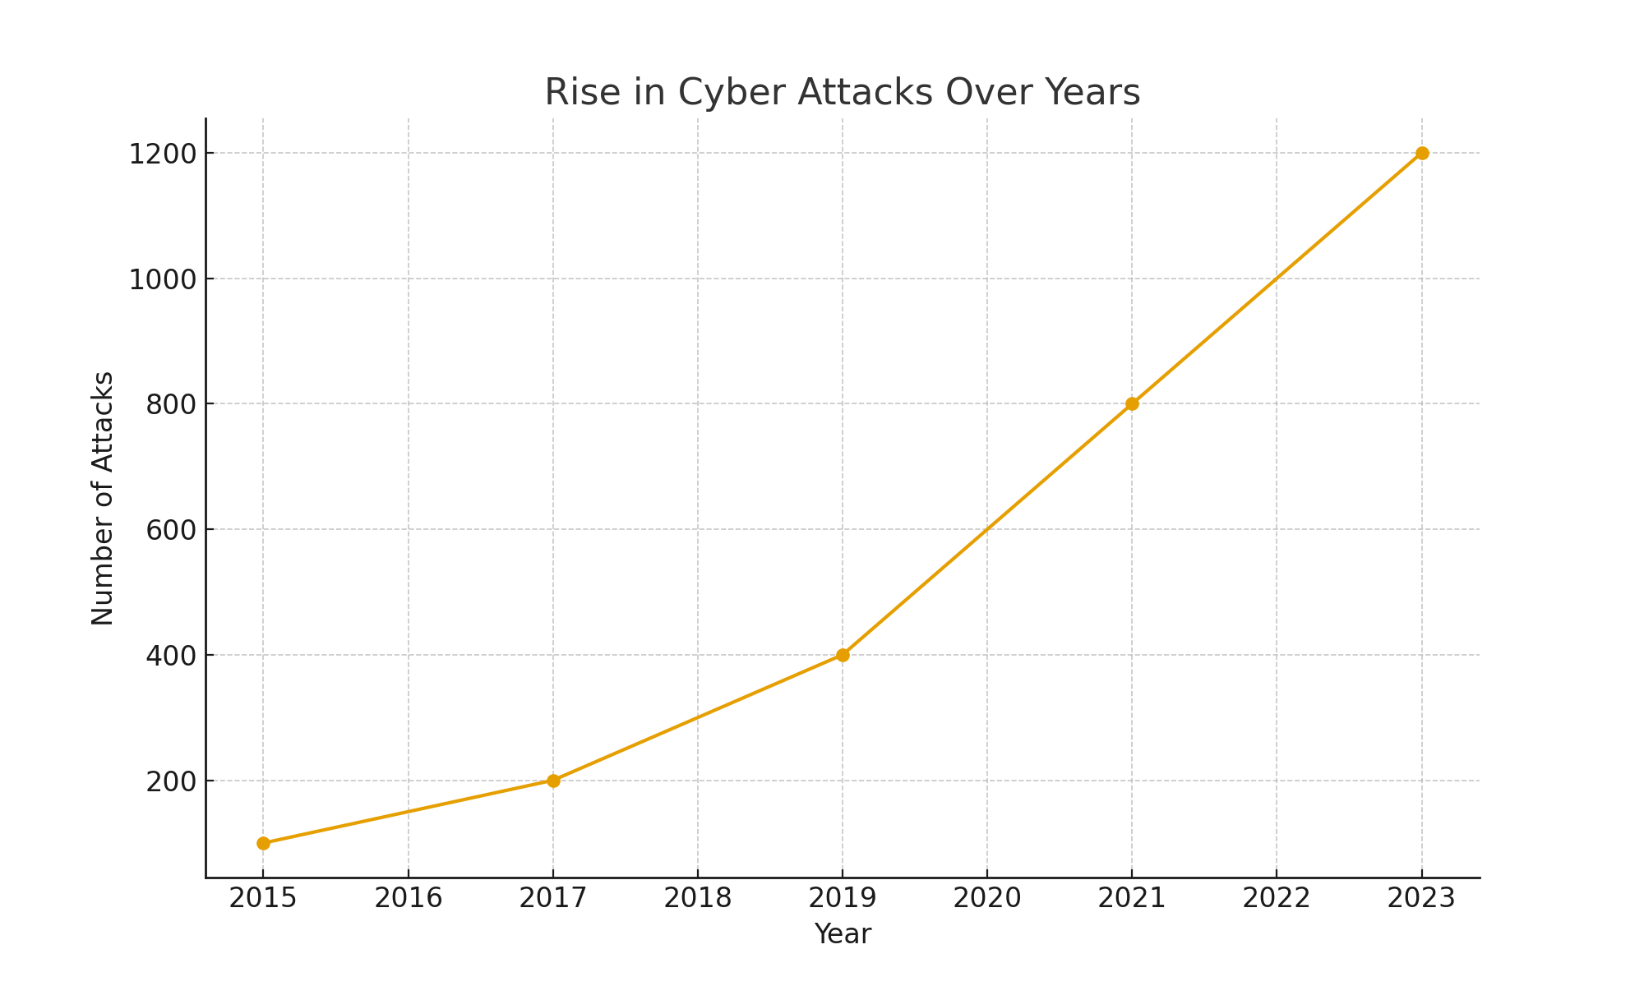
Cyber security Statistics
• 300% increase in cybercrime since 2015
• Billions lost annually to cyber-attacks
• 90% of breaches caused by human error

Slide 5

Best Practices & Conclusion
• Use strong passwords & two-factor authentication
• Keep software updated
• Avoid suspicious links/emails
• Educate employees & students
Learn more at CISA: https://www.cisa.gov

